Slide 1


Network Security
for Public, Private and Hybrid-Clouds
Advanced Threat Prevention
Automated & Cloud-Native
Unified Management
Notes:
I’d like to present CloudGuard Network Security
Providing advanced threat prevention, that is automated and cloud-native, with unified security management for Public, Private and Hybrid-Clouds.
-----------------------------------
[This presentation is focused on existing CP network security customers.
If this is a net-new customer, please fine-tune this presentation.
If the audience is CP customer but attendees are cloud security engineers who don't have CP on-prem experience, please fine-tune this presentation.
This is an overview presentation to be used by account managers, CAMs and CSSs.
It includes optional sections with more details and use cases.
Use them if you want, if you are comfortable with them, and if you need this additional detail.
Our intention is that all slides should be used by AMs, CAMs and CSSs so please use the speaker notes to help you to get comfortable with these and LEVEL UP!
It is intended as a "hook" - to explain the basics of CGNS and its benefits to customers.
Hopefully the customer will say "I was not aware of this, it makes good sense, please tell me more".
Next stage is for the CSA/SE to share a more technical story with the customer's cloud security engineers, perhaps leading to a demo or customized workshop or trial/POC.
For deeper, more technical presentations, please visit the CGNS product enablement wiki.]

Slide 2
Intro/overview slides
TBD Trisha
Notes:
CloudGuard intro, number of our successes and deployments with our customers.
Accolades, etc

Slide 3







Notes:
[Problem Statement for existing CP customers.
This is an optional slide depending on your audience, and this can be a voice-over for the next slide.]
You’re a current Check Point on-prem customer.
<Click>
You’re in the process of migrating to the cloud.
<click>
Perhaps even multi-cloud or hybrid cloud.
<click>
You need to reduce business risk, so you want the best security in the cloud as well.
<click>
your security team is already overloaded and doesn’t have time and resources.
<click>
so you’d like to keep everything consistent to reduce risk and minimize the additional overhead.
------------------------------------------------
TBD?
Ori/Hezi: perhaps add content to explain about the risks in the cloud – this could be another hidden slide.

Slide 4



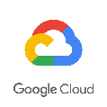
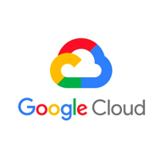
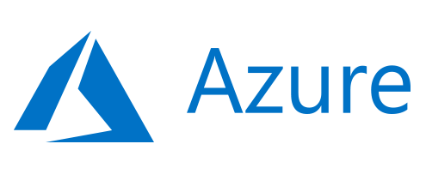
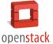

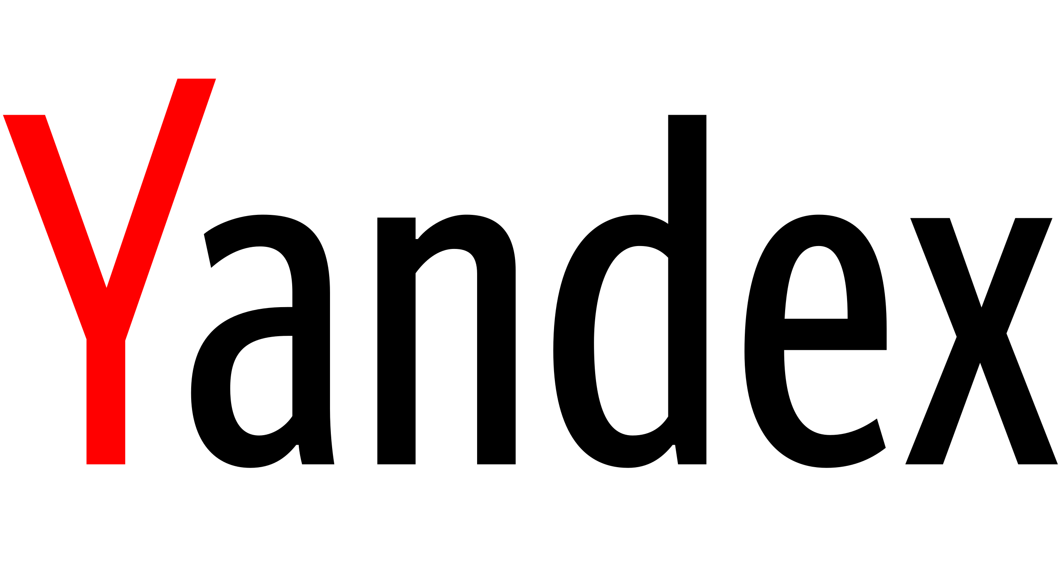
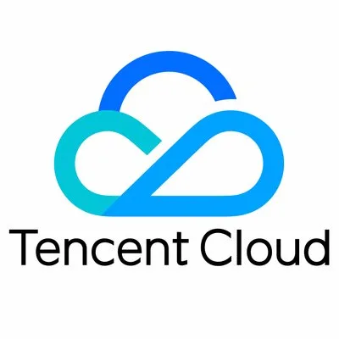
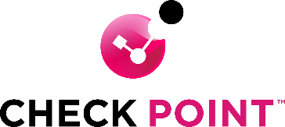
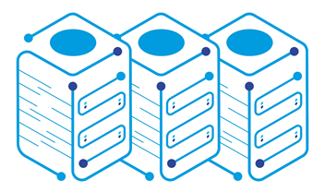
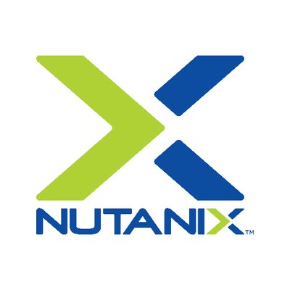
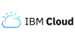
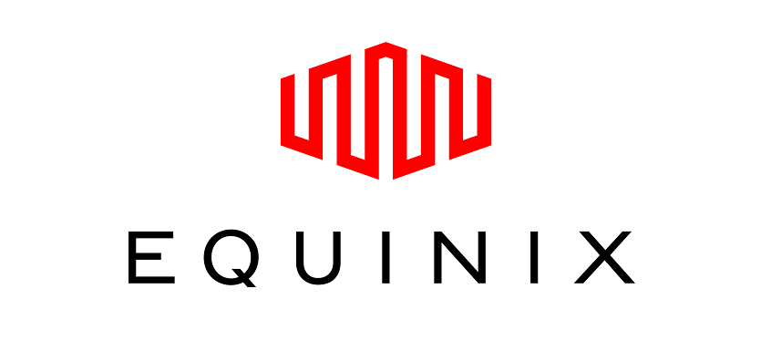

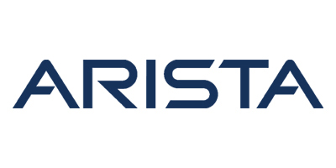
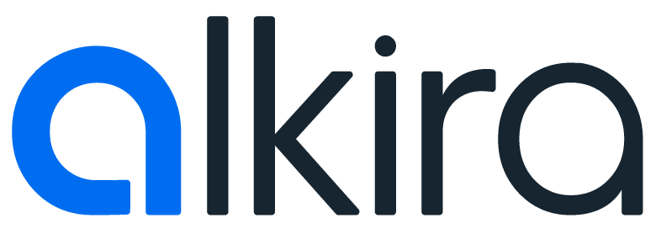
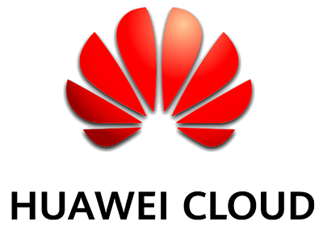
EXTEND YOUR NETWORK SECURITY TO THE CLOUD
ACI
Industry-leading advanced threat prevention for public, private and hybrid clouds
Notes:
[If you didn’t use the previous optional slide, use this]
You’re a current Check Point on-prem customer.
And you’re in the process of migrating to the cloud.
Perhaps even multi-cloud or hybrid cloud.
You need to reduce business risk, so you want the best security in the cloud as well.
Your security team is already overloaded and doesn’t have time and resources.
so you’d like to keep everything consistent to reduce risk and minimize the additional overhead.
[Until here]
-------------------------
[Now continue]
We’ve extended the best-in-class on-prem security to all your clouds
<click>
To provide industry-leading advanced threat prevention
<click>

Slide 5






Natively in the Cloud
ALL THE FEATURES OF CHECK POINT SECURITY MANAGEMENT
SECURITY BLADES
POLICY MANAGEMENT
VISIBILITY
LOGGING
REPORTING & CONTROL
Same security technologies as on-premises
Manage consistent policies for all clouds and on-premises
Understand network traffic patterns and behaviors
Investigate incidents and enable forensics
Reduce security management overhead and increase efficiency
©2023 Check Point Software Technologies Ltd.
5
Notes:
You get all the great features of Check Point’s gold standard security management from a single pane-of-glass, so you have the same:
- Security blades
- Policy management
- Visibility
- Logging, reporting and control
That we have built to our customers’ requirements and needs over 30 years
------------------------
Should we change the header font to match the others (caps?)

Slide 6






Cloud-Native Benefits
INTEGRATED
UP-TO-DATE
EASY TO DEPLOY
ELASTIC
AGILE
SCALABLE
Cloud-Ready across all public, private and hybrid-cloud vendors
©2023 Check Point Software Technologies Ltd.
6
Notes:
We made it cloud-native so it is:
Always integrated with all those vendors and up-to-date with their latest services
Easy-to deploy
Elastic, agile and highly scalable
We have a very close partnership with all the vendors and integrate with all of their popular and newest services, which ensures that our customers always have the best cloud-native user experience.
In other words, Check Point’s network security is completely cloud-ready.
------------------------
Integrated: (See in a few slides): Check Point's cloud network security is integrated with all the popular public and private cloud vendors, and is a design partner of the latest networking services
Up-to-date: These integrations are continuously maintained to take advantage of the latest cloud features and functionality.
Easy to deploy: The cloud security gateways and the cloud management can be deployed via the cloud Marketplaces, or using popular automation and configuration management tools like AWS CloudFormation, Ansible or Terraform
Elastic:
Agile:
Scalable: (See in a few slides) [ Check Point integrates with the scaling services of all clouds, and allows customers to easily scale-out to meet increased demand, and scale-in when demand drops for cost avoidance and cost optimization. ]
--------------------------
Should we change the look and feel to match the previous color (otherwise it is grey)

Slide 7
Optional slides #1
What does it mean to be cloud-ready?
Notes:
Please review these slides before presenting. You can choose to use them if needed and if you are comfortable presenting them.

Slide 8
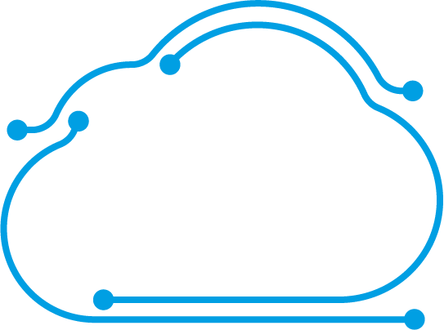

CHECK POINT IS CLOUD-READY
Cloud-Aware
2
Updated policies
Controller
Asset changes
1
©2023 Check Point Software Technologies Ltd.
8
Notes:
What does it mean to be cloud-ready?
We added a bunch of bells, whistles and integrations to suit our customers’ needs. Let’s look at some of these benefits.
<click>
Firstly, Check Point cloud network security is cloud-asset-aware – it provides adaptive security policy to the changes in your cloud assets.
<click>
Cloud assets change all the time. The security policies and rules need to be updated automatically and quickly so as not to block the organization.
<click>
The Controller [part of Check Point Security Management] scans and retrieves cloud asset changes [using the cloud vendor’s official APIs] and automatically updates policy on the gateways.
I’ll show a use case in a few slides time.

Slide 9
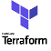
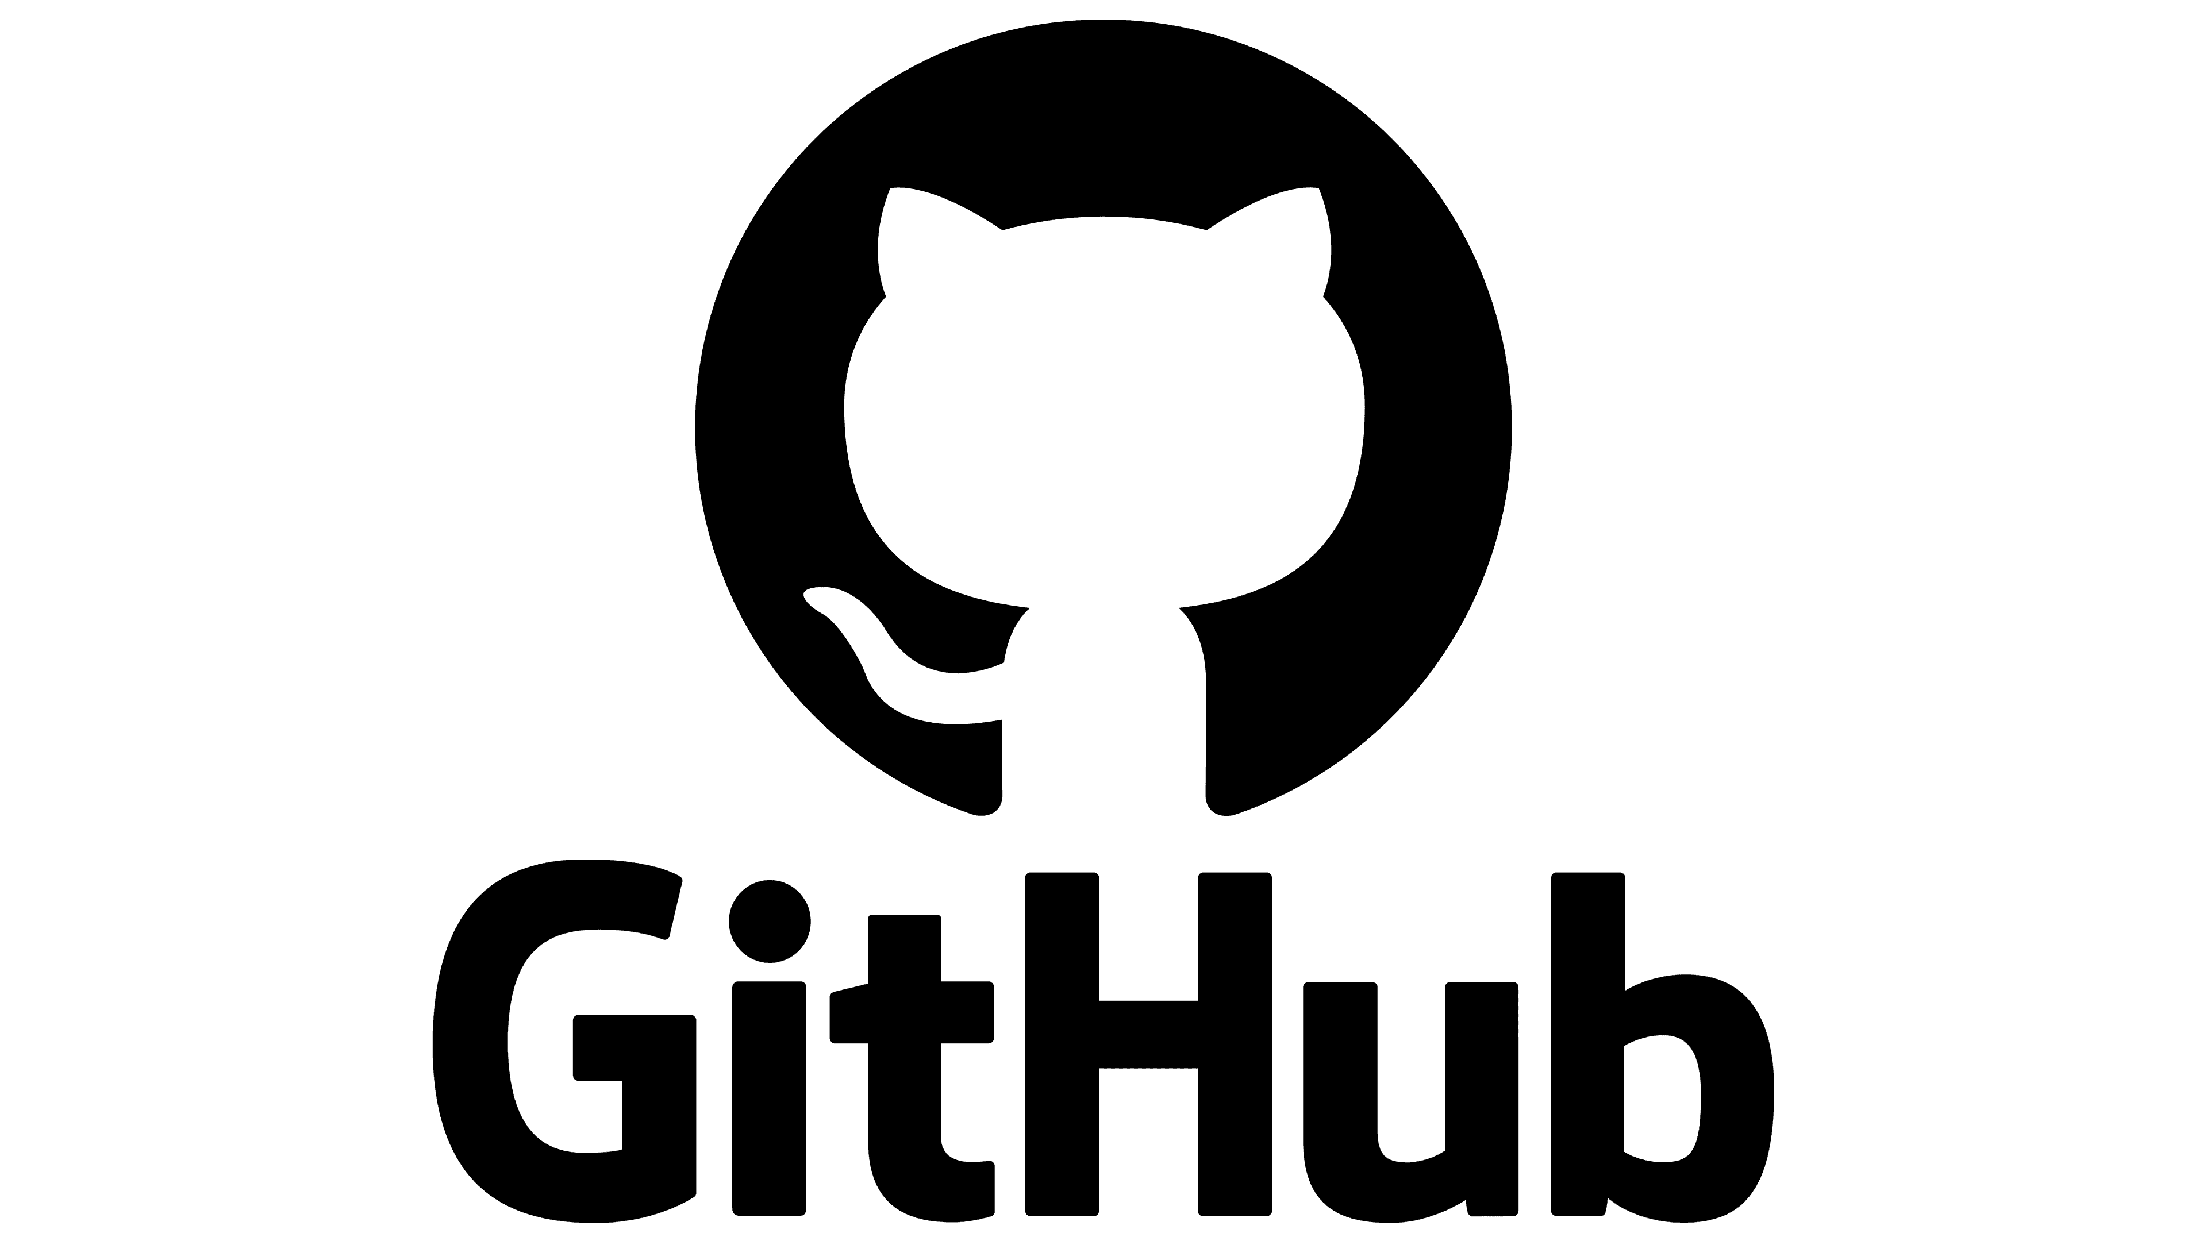
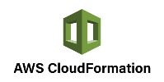
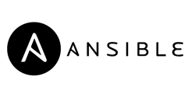
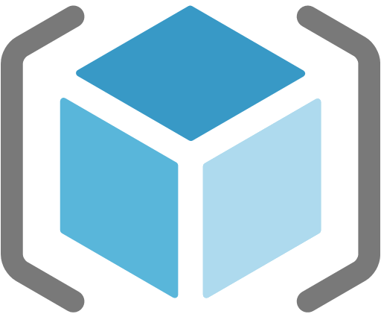
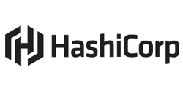
CHECK POINT IS CLOUD-READY
Cloud-Aware
Cloud-Automated
Azure Resource Manager
©2023 Check Point Software Technologies Ltd.
9
Notes:
Cloud solutions must be fully-automated to enable cloud agility.
<click>
Check Point integrates with all the leading configuration management tools for efficient and agile cloud operations.

Slide 10


CHECK POINT IS CLOUD-READY
Cloud-Aware
High demand → growth
Low demand → avoided cost
Internet
Cloud-Automated
Cloud-Scalable
Corporate HQ
©2023 Check Point Software Technologies Ltd.
10
Notes:
The cloud is highly scalable to meet changing business needs and optimize costs.
Check Point integrates with the scaling services of all clouds, and allows customers to
<click>
easily scale-out to meet increased demand, and
<click>
scale-in when demand drops for cost avoidance and cost optimization.

Slide 11
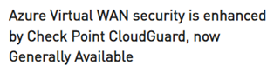
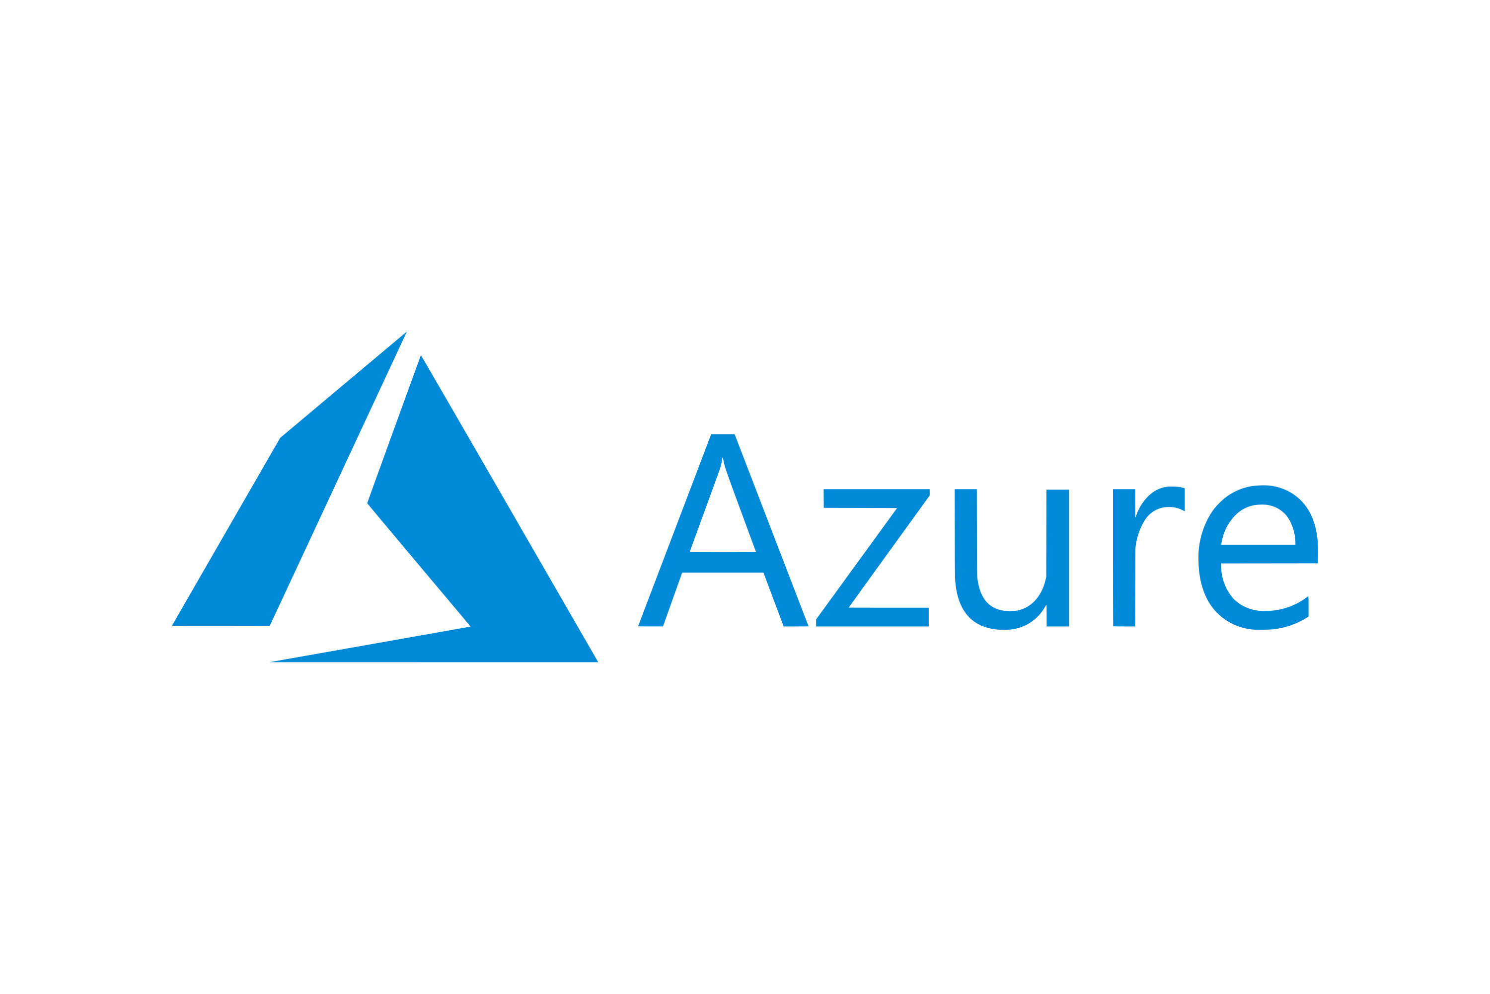
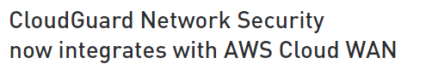
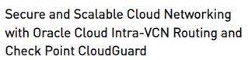
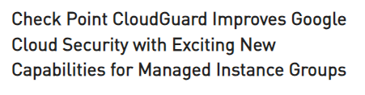
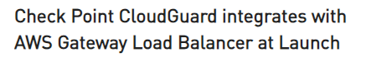
CHECK POINT IS CLOUD-READY
Cloud-Aware
Design partner of the latest cloud networking services
Cloud-Automated
Cloud-Scalable
Cloud-Efficient
©2023 Check Point Software Technologies Ltd.
11
Notes:
Cloud security must be efficient and cloud-easy, to minimize the operational overhead on your already-overworked security team.
<click>
Check Point is a design partner of the latest networking services, which streamline the operations of customer security teams.

Slide 12
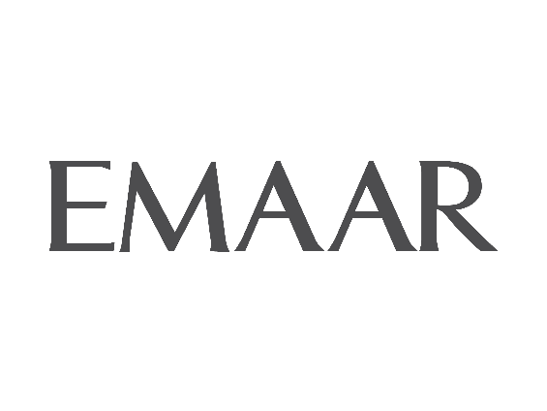



ENHANCING CLOUD SECURITY FOR 4000+ CUSTOMERS
“We gained the highest level of security across our premises and cloud infrastructures. Check Point delivered the threat prevention, scalability, and manageability we needed. At the same time, we’re well positioned to begin adopting a zero-trust framework as we move into the future.”
Binoo Joseph,
Group CTO/CIO, Emaar
“To protect Scotland’s health data we need to ensure the data is secure at every point of entry. Having next-generation firewalls that are scalable and give us that protection is exactly what we need built on top of the public cloud.”
Deryck Mitchelson,
CISO, NHS Scotland
“As we work to create new features and functionalities the R&D team is able to work with third party or us directly to help find quick solves. Having that immediate contact with Check Point really is a life saver.”
Greg Smith, Director of Cyber Security, Hallmark
Notes:
Check Point is one of Microsoft’s top security partners globally and we have a very close partnership.
There are over 1000 successful customer deployments of CloudGuard for Azure – here is one from NHS Scotland which talks about the value and the outcome of their use of CloudGuard for the best Azure security.
<click>
AWS is the biggest cloud vendor, and CloudGuard is supported on AWS since January 2012.
Check Point is an AWS Advanced Technology Partner and CloudGuard is available in AWS Marketplace with hundreds of customers, most of them large enterprises.
There are a bunch of great AWS customer stories in our website – this example of Hallmark Cards is also a testimonial video in the AWS partner website.
<click>
And most large organizations have a hybrid-cloud strategy. Emaar is a large multinational real estate development company in the Middle East with Check Point network security on-prem, as well as in AWS, Azure and VMware private cloud – all from a single pane-of-glass

Slide 13




BEST-IN-CLASS CLOUD NETWORK SECURITY FOR MIGRATION
Most Secure
Quickest and Easiest
Minimizes Risk
Lowest TCO
©2023 Check Point Software Technologies Ltd.
13
Notes:
Short version:
If you have Check Point security gateways on-prem and are moving to the cloud…
It’s a no-brainer because we’ve extended best-of-class network security into all your favorite public and private clouds.
It is: Most Secure, Quickest and Easiest, Lowest Risk and ensures Lowest TCO.
And if your strategy is multi-cloud, you can control them all and your on-prem with the unified security management from a single-pane-of-glass.
Now let’s get into the details and see how this benefits you:
--------------------------------------------------
Long version:
If you have Check Point security gateways on-prem and are moving to the cloud…
It’s a no-brainer because we’ve extended best-of-class network security into all your favorite public and private clouds.
It is:
Most Secure: Same leading security GW blades/technologies
Quickest: No need for new training or integrations
Easiest: Uses the same management UI and policies as on-prem
Lowest Risk: You already trust CP security. Using another cloud security solution increases the organization’s risk. Go with a trusted security advisor.
Lowest TCO: No need for new staff or a learning curve (lowest TCO)
And if your strategy is multi-cloud, then you can control all your public clouds, private clouds and on-prem with the unified security management from a single-pane-of-glass.
Now let’s get into the details and see how this benefits you:

Slide 14

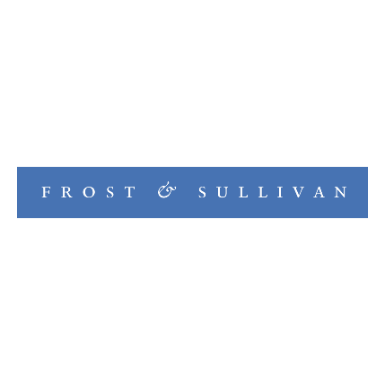





INDUSTRY-LEADING SECURITY
Next-Generation Firewall: Named a Leader in Gartner® Magic Quadrant™ Network Firewalls (23 times)
Ranked 1st in Public Cloud Use Case in Gartner® 2023 Critical Capabilities for Network Firewalls
AAA in CyberRatings Cloud Network Firewall
Leader in Forrester Wave™: Enterprise Firewall
Recommended AAA CyberRatings Enterprise Firewall
Leader in Miercom NGFW Security Efficacy
Leader in GigaOm Radar for NGFW Leader in GigaOm Radar for Cloud Network Security
Best-in-Class by Frost & Sullivan for NGFW
Report names: 2019-2022- Magic Quadrant for Network Firewalls, 2006-2018- Magic Quadrant for Enterprise Network Firewalls, 2002- Firewall 2H02 Magic Quadrant; 2004- Magic Quadrant for Enterprise Firewalls, 2H03, 2000-2001- Firewall Market Magic Quadrant Update, 1999- Firewall Positioning for 2H99: The High Security Specialists, 1998- Magic Quadrant for Firewall and Virtual Private Network Products, 1997- Cisco Systems - The Align and Conquer Strategy.
14
Notes:
Most importantly, Check Point network security is recognized by industry analysts as a long-term leader, including these proofpoints, for example a recent Gartner report ranked CP as the best vendor for the Public Cloud Network Firewall use case.
--------------------------------------------------------------------------------------------------------
Note that Gartner has very clear guidelines about what we can present externally
For this slide, we are following Gartner’s clear guidelines
Below (and at bottom of this slide), we provide the report attribution in the order of most recent to last in the smallest font the “first time” it is mentioned in the presentation.
Report names: 2019-2022- Magic Quadrant for Network Firewalls, 2006-2018- Magic Quadrant for Enterprise Network Firewalls, 2002- Firewall 2H02 Magic Quadrant; 2004- Magic Quadrant for Enterprise Firewalls, 2H03, 2000-2001- Firewall Market Magic Quadrant Update, 1999- Firewall Positioning for 2H99: The High Security Specialists, 1998- Magic Quadrant for Firewall and Virtual Private Network Products, 1997- Cisco Systems - The Align and Conquer Strategy.
(note: the 1997 Cisco Systems document has the earliest viewable Gartner MQ chart that reflects us being recognized as a leader. This is affirmed by Gartner)

Slide 15

INDUSTRY-LEADING SECURITY
HIGHEST CATCH RATE FOR ZERO-DAY THREAT PREVENTION BY MIERCOM ®
MALWARE PREVENTION EFFICACY
ZERO+1 DAY MALWARE , NGFW COMPARISION
99.7%
Percent prevented
72.7%
46.1%
43.6%
15
Notes:
additionally
Check Point was ranked # 1 in 2023 Miercom Firewall Benchmark Tests vs. other vendors, scoring a 99.7% malware block rate, versus 72.7% for the nearest competitor

Slide 16
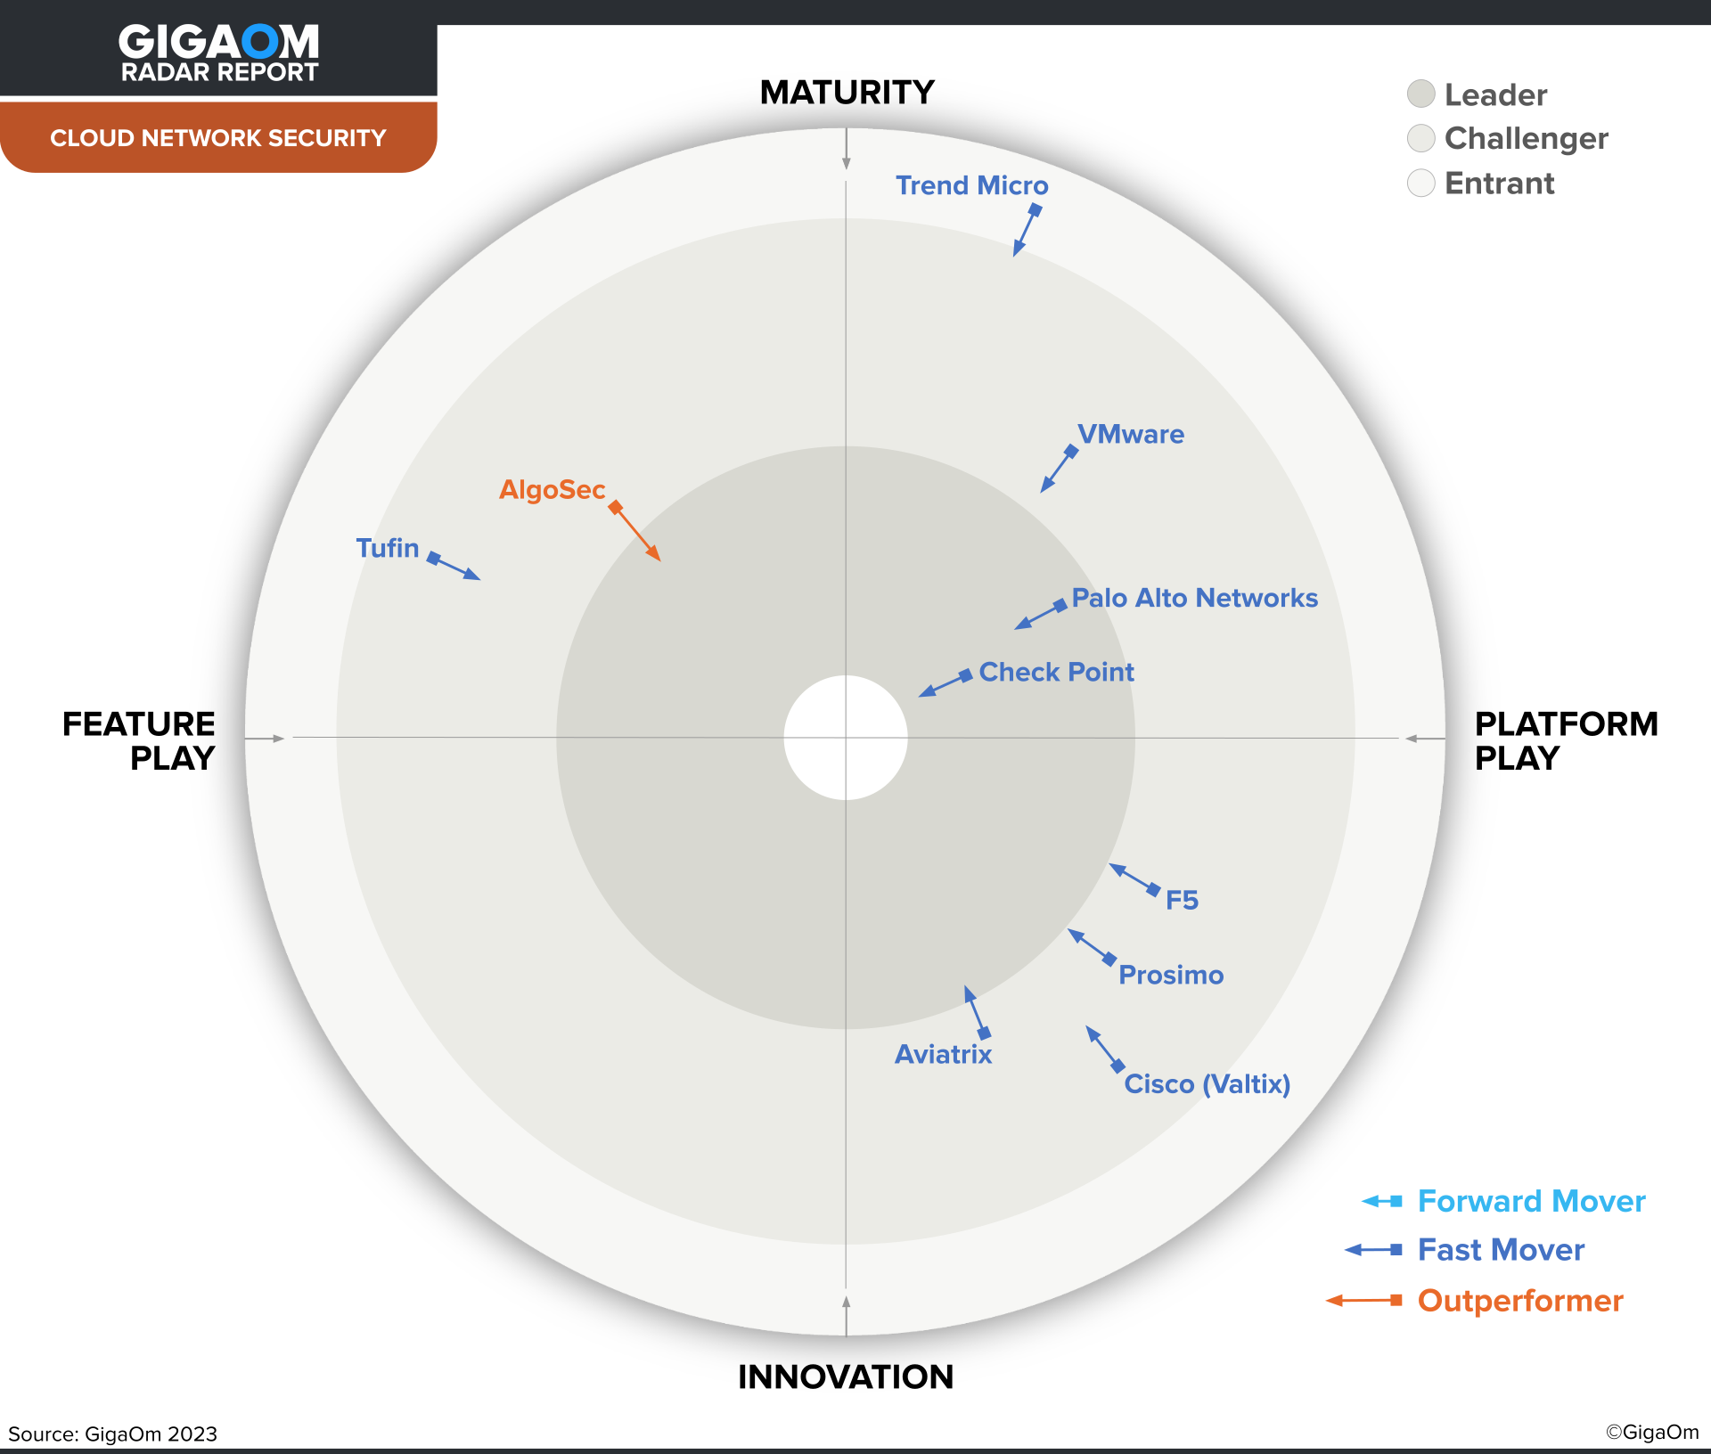
INDUSTRY-LEADING SECURITY
16
Notes:
And in Q4 2023, Check Point was ranked as The Leader and a Fast Mover in GigaOm's Radar for Cloud Network Security
(We are also expecting an important new lab assessment and will update as soon as it is released)

Slide 17

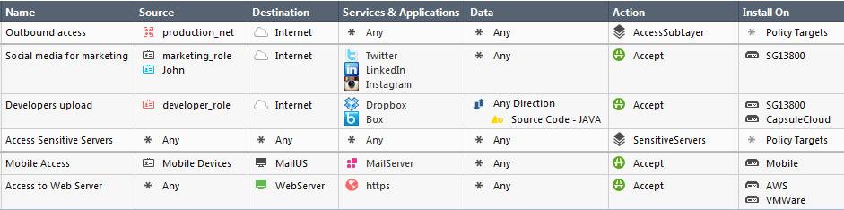
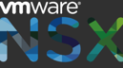
QUICKEST AND EASIEST FOR MIGRATION
Extend your security policies to the cloud
No new integrations required
No need to manage multiple security solutions
Users
Cloud Assets
Applications
Data
Gateways
Public Cloud
Private Cloud
Automation-ready for CloudOps
©2023 Check Point Software Technologies Ltd.
17
Notes:
Secondly, If you are already a Check Point network security customer, then using Check Point’s cloud network security is quickest and easiest for your migration and to secure your cloud after migration.
<click>
This is because you can easily extend your stable on-prem security policies to the cloud. Plus you won’t have any policy mismatches between your on-prem and all your clouds.
<click>
No need for new integrations with your IT and security SW stack
<click>
There is no need to manage multiple security solutions
<click>
And CloudGuard is automation-ready to make it quickest and easiest for your Operations and Security teams to work together

Slide 18
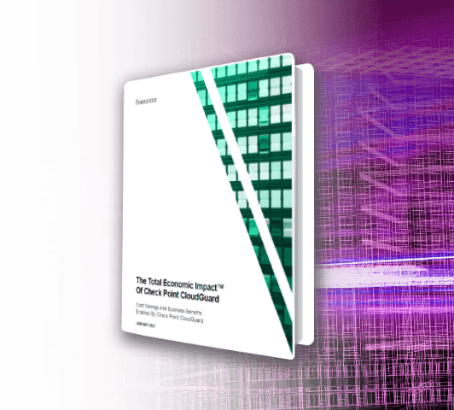

LOWEST TOTAL COST OF OWNERSHIP
Reduced organizational risk
169%
Return on Investment
Highest ROI for Check Point customers
$2.43M
Total Benefits
<3 Months
Payback Period
No need to hire or train engineers
$1.25M
Net Present Value
Minimized time-to-production
©2023 Check Point Software Technologies Ltd.
18
Notes:
Check Point cloud security also has the lowest total cost of ownership.
<click>
Your on-prem security is stable and approved – why add risk? Like a new solution and new vendor, new integrations, policy mismatches, etc.
<click>
Check Point customers have lowest TCO because of the ease of extending on-prem network security to your clouds.
<click>
You don’t need to hire engineers or train your security team on CloudGuard because it is the exact same software as your on-prem network security
<click>
So you are quickest to production
As a proof-point to back this up,
<click>
Forrester published a Total Economic Impact report on using CloudGuard, which showed 169% ROI over 3 years and a total payback period of < 3 months
Customers that are confident with their cloud security move more workloads to the cloud, quicker.

Slide 19
OPTIONAL SLIDES #2
MINIMIZING RISK ACROSS
CRITICAL CUSTOMER USE CASES
Notes:
Please review these slides before presenting. You can choose to use them if needed and if you are comfortable presenting them.

Slide 20
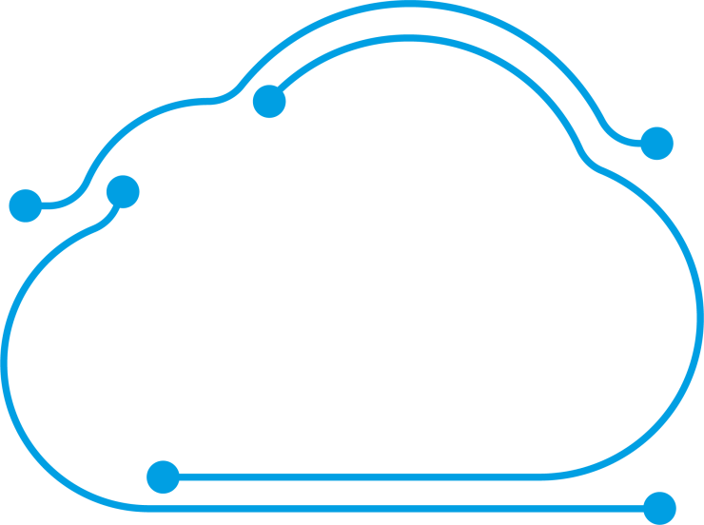

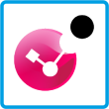
MINIMIZING RISK ACROSS CRITICAL CUSTOMER USE CASES
Internet
Secure your
Cloud Migration
A
B
C
Corporate HQ
Notes:
Let’s see how customers minimize their risk by looking at some common customer use cases:
Firstly, when you use CloudGuard to secure your migration, this minimizes your risk, because it is security that you already know and trust.
<click>
I mentioned before that it is quick and easy to secure your assets and workloads in the cloud.
All you need is to
<click>
deploy CloudGuard gateways to inspect incoming and outgoing traffic.

Slide 21
MINIMIZING RISK ACROSS CRITICAL CUSTOMER USE CASES
Internet
Secure your
Cloud Migration
North-South and East-West Threat Prevention
A
B
Anti-Bot
C
Corporate HQ
Notes:
Check Point uses the same 3rd-party validated network security blades to protect your cloud, including traffic entering and exiting your cloud deployment (North-South), and
<click>
Lateral traffic inside your cloud (East-West).
<click>
In this use case, North-South traffic
<click>
is flagged by the anti-bot blade and
<click>
blocked from getting out to the internet

Slide 22
MINIMIZING RISK ACROSS CRITICAL CUSTOMER USE CASES
Internet
Secure your
Cloud Migration
North-South and East-West Threat Prevention
A
B
IPS
C
Corporate HQ
Notes:
<click>
Here’s an example of another threat prevention blade at work.
<click>
An attacker is attempting to do reconnaissance using vulnerabilities.
<click>
And East-West traffic is blocked from laterally infecting another workload in the cloud network

Slide 23
MINIMIZING RISK ACROSS CRITICAL CUSTOMER USE CASES
Internet
Secure your
Cloud Migration
New cloud asset is created
North-South and East-West Threat Prevention
A
B
D
C
Zero-Trust
Network Segmentation
Corporate HQ
Notes:
CloudGuard has flexible and granular access controls which enable zero-trust least privilege.
Secure connectivity and segmentation minimize lateral movement and control the blast radius.
<click>
In this use case, a new asset is created by a developer.

Slide 24
MINIMIZING RISK ACROSS CRITICAL CUSTOMER USE CASES
Internet
Secure your
Cloud Migration
New cloud asset is created
North-South and East-West Threat Prevention
A
Untagged asset gets minimum permissions
B
D
C
Zero-Trust
Network Segmentation
Corporate HQ
Notes:
We talked before about how CloudGuard is cloud-aware. In this case, the new asset is automatically discovered.
If the asset is not given a tag, the zero trust principle implies it will receive minimal permissions
<click>
and most traffic flows are blocked.

Slide 25
MINIMIZING RISK ACROSS CRITICAL CUSTOMER USE CASES
Internet
Secure your
Cloud Migration
New cloud asset is created
North-South and East-West Threat Prevention
A
Untagged asset gets minimal permissions
B
D
C
Tag
Type=Dev
Zero-Trust
Network Segmentation
Tagged asset gets suitable permissions
Corporate HQ
Notes:
Once the developer adds the correct tag
<click>
The asset receives suitable permissions
<click>
and can send and receive traffic according to the pre-defined policies

Slide 26




MINIMIZING RISK ACROSS CRITICAL CUSTOMER USE CASES
Secure your
Cloud Migration
VNet 2
VNet 1
VNet 3
North-South and East-West Threat Prevention
Zero-Trust
Network Segmentation
Centralized and
Efficient Security
Headquarters
Remote Users
Branch
Notes:
Another critical use case is to enable efficient security operations by consolidating and centralizing all the security use cases.
<click>
In this example, Microsoft Azure Virtual WAN is a cloud networking service that connects multiple Azure regions, on-premises sites, remote users and branch offices via a central hub.
<click>
CloudGuard is natively integrated with this service and is automatically deployed inside this hub.
This centralizes and simplifies security operations, enables greater consistency with better operational efficiency for the security team.
Now let’s look how this extends easily to multi-clouds and hybrid clouds

Slide 27
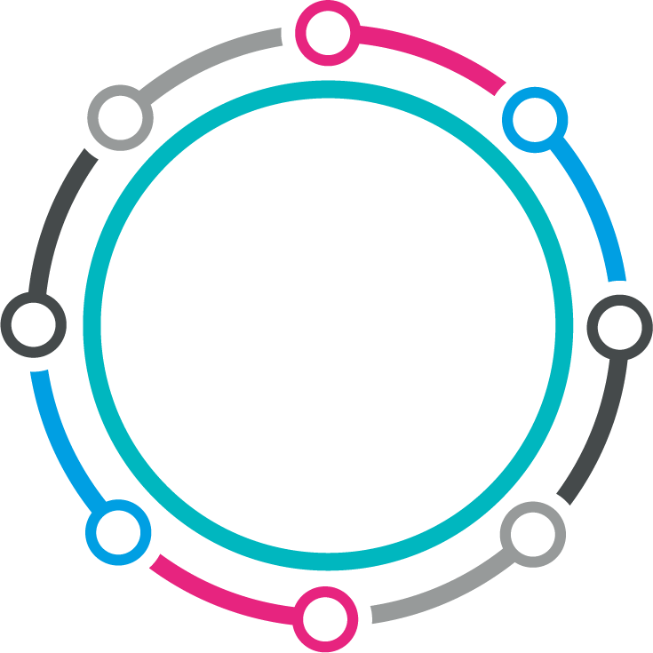



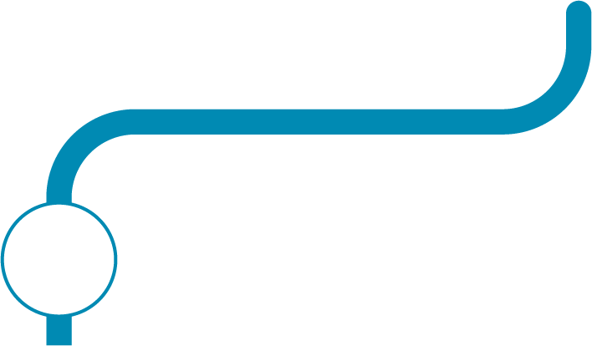



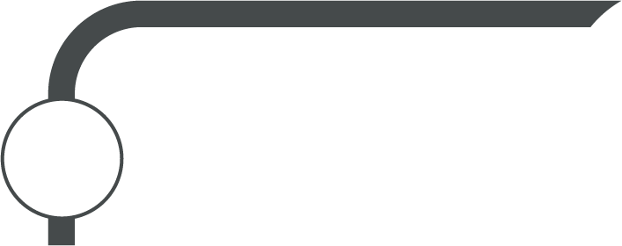
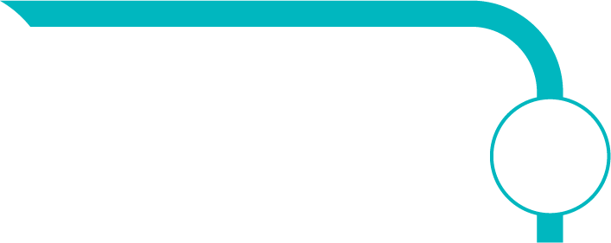

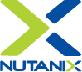
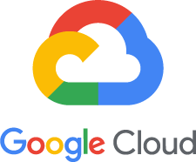



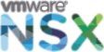
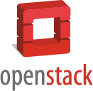
UNIFIED SECURITY FOR PUBLIC, PRIVATE AND HYBRID-CLOUDS
Corporate HQ
Unified Management
Notes:
The previous use cases referred to a deployment using a single cloud vendor, but these use cases apply equally to all clouds.
<click>
If you have a multi-cloud or hybrid-cloud strategy, or you want to ensure consistency between your cloud and on-prem, Check Point Unified Security Management provides visibility, policy management, logging and reporting across all your cloud environments, and on-prem, all from a single pane-of-glass
And if we’re already talking about multi-clouds,
Why do our customers choose Check Point cloud network security over the offerings of the cloud vendors?

Slide 28
CUSTOMERS CHOOSE CHECK POINT OVER CLOUD VENDOR SECURITY
SECURITY VALUE
OPERATIONAL VALUE
Industry-leading
Multi-cloud and hybrid-cloud
Prevents unknown threats
Lowest TCO
Granular policies
Ease of use, logging & reporting
Notes:
Firstly – for pure security reasons:<click>
- For cloud vendors, security is just another add-on - another line-item. For Check Point, security is all that we do. Check Point is recognized by analysts as a long-term industry leader, while the cloud vendors are considered “niche players” [by Gartner in the 2022 Network Firewall Magic Quadrant], who don’t cover all the security use cases.
- In other words, there is huge difference in the depth of security. One example is unknown threats, [which pose critical risks to businesses and are the hardest to prevent. A user or software downloading a file (such as an update) will not be protected if that file is malicious, leading to infection.] Check Point uses sandbox emulation to discover these zero-day threats, and at the same time sanitizes these files and delivers safe files in seconds. Cloud vendors don’t have these capabilities.
- Another example is policy granularity. Cloud vendors are limited to simplistic policies [5-tuple matching + HTTP header], while Check Point expands this with multiple factors, including Application, User, Time, and much more. For example, Check Point allows you to block a specific service, such as “upload to Gmail” - Can your cloud vendor security do that?
There are also killer operational reasons why companies prefer Check Point’s solution over their cloud vendor’s network security:
<click>
- Most organizations have a multi-cloud or hybrid-cloud strategy. And even if you’re only using a single cloud now, do you know what your business will require in 1 year? In 3 years? How can you ensure consistent policies between your clouds? And between your cloud and your on-prem? For most of the organizations that we speak with, this is one of the main reasons they choose Check Point.
- I already spoke about the business value for Check Point on-prem customers to choose CloudGuard – this is even more obvious when compared to cloud vendor security [where you pay much more and you get an entry-level product]. I’ll be happy to schedule a separate discussion for a financial deep-dive comparison. And if you remember the Forrester report? That was compared to cloud vendor security.
- It should be easy to use because it is the same management that you use on-prem. And there are loads of other proof points around ease of use. One example is that all capabilities are behind a single pane-of-glass, where cloud security vendors have multiple consoles, [e.g. Azure has 5 different consoles: Security Groups, Azure Firewall, Microsoft Defender, Azure Policy, Azure Sentinel]. Another example is logging capabilities, where Gartner says Azure “lacks support for debugging issues”.
And if your cloud vendor already bundled their network security into your current contract, that’s ok. Check Point is the correct solution for more critical business applications – it enhances and complements your cloud vendor’s security solution.
Another example of ease-of-use is our licensing.

Slide 29
EASY AND INTUITIVE LICENSING
Bring Your Own License (BYOL)
Pay As You Go (PAYG)
Purchase from channel partner
Charged by # cores
Portable licenses
Automatic license allocation
On cloud vendor Marketplaces
License “built-into” cost of cloud instance
Annual OR on-demand/per-hour
Line item in cloud vendor invoice
29
Notes:
CloudGuard Network Security is licensed in the following ways
Bring-your-own-license
Purchase from your Check Point channel partner
Charged by number of cores used
Licenses are portable across all public/private clouds
They are automatically allocated via the CloudGuard Central License Utility
[If using Auto-Scaling group you must have enough licenses to cover a scale-out event]
<click>
Pay-as-you-Go
Here you purchase from the cloud vendor marketplaces
You still pay by # cores, but here the Check Point license is “built-into” the cost of the cloud instance
You can choose to purchase an annual license, which is paid up front, or you can choose on-demand/per-hour, which is billed monthly in your regular cloud vendor invoice.
Only available in Azure, AWS, Google Cloud, Oracle Cloud, and Alibaba Cloud marketplaces
If you’d like additional details of the licensing, we can make a note of that for later

Slide 30



SUMMARY
World-Class Threat Prevention
Automated and Cloud-Native
Unified Management
©2022 Check Point Software Technologies Ltd.
30
Notes:
Short version:
To summarize:
We extended the best-in-class on-prem security to all clouds with the same security blades, recognized as a long-term leader by 3rd-party analysts.
We made it cloud-native so it is always integrated and up-to-date, easy-to deploy, elastic, agile and highly scalable, supporting full automation
And Check Point Security Management allows consistency across all public and private-clouds and on-prem, from a single pane-of-glass
--------------------------------------------------
Long version:
To summarize:
We extended the best-in-class on-prem security to all your clouds with the same industry-leading threat prevention as Check Point’s physical network security appliances, recognized as a long-term leader by industry analysts and objective testing labs.
We made it cloud-native so it is always integrated and up-to-date, easy-to deploy, elastic, agile and highly scalable to support dynamic traffic growth, and it supports full automation using the popular configuration management tools
As you know, Check Point Security Management provides consistent visibility, policy management, logging, reporting and control across all public and private-cloud environments, as well as for on-premises deployments, all from a single pane-of-glass
------------------------------------------------------
More detailed notes:
Always lead with security
Most secure threat prevention with industry-leading catch rate of malware, ransomware and other types of attacks.
Recognized as a long-term leader by third-party analysts: 23 consecutive years as a Leader on the Gartner Magic Quadrant for Network Firewall, Forrester, Miercom
All of CP’s industry-leading security technologies/blades, same as Quantum
Automated and cloud-native
Built for cloud principles of elasticity, agility, availability, resilience, with high scalability to support dynamic traffic growth and business needs
Enables rapid deployment via the public cloud Marketplaces: uses templates of AWS CloudFormation, Azure Resource Manager and other public cloud vendors.
Integrated with leading configuration management tools including Terraform and Ansible: command and control cloud-native security gateways programmatically, supporting Infrastructure As Code, CI/CD practices, automation of processes using APIs and security automation use cases for response and remediation teams.
Unified Management Across All Clouds
Extend on-premises security posture to the cloud easily, quickly and intuitively: ensures secure cloud migration and increases operational efficiency without the complexity of additional security solutions.
Check Point’s “gold standard” unified security management console provides consistent visibility and control across public, private and hybrid clouds as well as on-prem, all from a single pane-of-glass.
Collects and leverages contextual information about cloud configurations: using asset tags, objects, security groups and more to automatically adjust security policies after any changes in dynamic cloud environments.
----------------------------------
TBD?
Geert: Separate deck for private-cloud only, e.g. NSX – there are lots of customers interested – we have battles to win there – some big wins
-------------------------------------------------------
Trisha/TJ suggests unified management dedicated slide after use cases
Should we swap pillars A and B

Slide 31







READY FOR THE NEXT STEP?
Learn more at checkpoint.com/cgns
Scheduled a personalized workshop
Purchase on
Marketplaces
Deep-dive with a Security Engineer
Get a 1:1 demo with a Cloud Security Architect
Watch
technical webinars
Notes:
Are you ready for the next step?
[Read the different CTAs]

Slide 32
Thank you
Advanced Threat Prevention
Automated Network Security
Unified Management

Slide 33
BACKUP

Slide 34

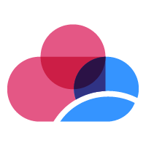
Check Point Cloud Security Blueprint
Agile Security architecture that enables DevOps innovation
Efficient Automatically deploy, provision, & scale security in the Cloud
Multi-Clouds Unified security architecture for all environments
Notes:
Our principles for the cloud security blueprint: Agile, Efficient and multi-cloud.

Slide 35
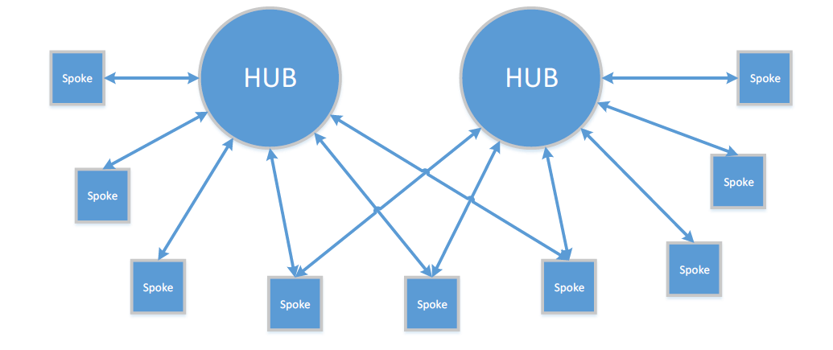
Hub-and-spoke Model
Notes:
This model provides cost savings and efficiency gains by simplifying the overall design
Also provides separation of concerns (devs, infrastructure, LoB apps etc)
Helps to overcome some subscription limits regarding Vnet peerings

Slide 36


Architecting in the Cloud | The Blueprint | Two-Hub Design
WWW
North Hub
DEV
TEST
PROD
…
PROD
South Hub
VPN
[Protected] Distribution or modification is subject to approval ​
Notes:
This is the wall of the cloud, there are two openings being entry and exit. Within that wall everything is allowed.
Spoke are DevOps but also regular developers, MIS applications and more. Spokes can be added and removed and should not be hindered by security.
The Spokes are isolated work environments. Spokes may either need to be accessed from the internet or need access to the Internet
Now we need to handle the internet traffic and thus put hubs at the ingress/egress points to control the flow.
Here is where we deploy the CP CloudGuard Network Security with Advanced Threat Prevention
Some Spokes are public facing only, like a production environment
Some internal facing only, like a Development environment. On-premises connected through VPN.
Lateral traffic moves through the SouthBound
Some Spokes are public facing only (Production), some internal facing only (Development) or both (Test). On-premises connected through VPN.

Slide 37

Architecting in the Cloud | The Blueprint | Conclusion
As Spoke owner I can add, remove and scale my applications at anytime, at any required speed
DEV
TEST
PROD
…
PROD
[Protected] Distribution or modification is subject to approval ​

Slide 38

Architecting in the Cloud | The Blueprint | Conclusion
As Hub owner I have control and visibility on lateral and perimeter traffic
North Hub
DEV
TEST
PROD
…
PROD
South Hub
[Protected] Distribution or modification is subject to approval ​

Slide 39



Architecting in the Cloud | The Blueprint | Conclusion
As DevSecOps I have security & control without slowing anyone down
Advanced threat prevention using CloudGuard adaptive security
North Hub
New environments (spokes) are automatically secured
DEV
TEST
PROD
…
PROD
Segmented environments allow isolation of infected areas
South Hub
Security deployments are automated
[Protected] Distribution or modification is subject to approval ​

Slide 40
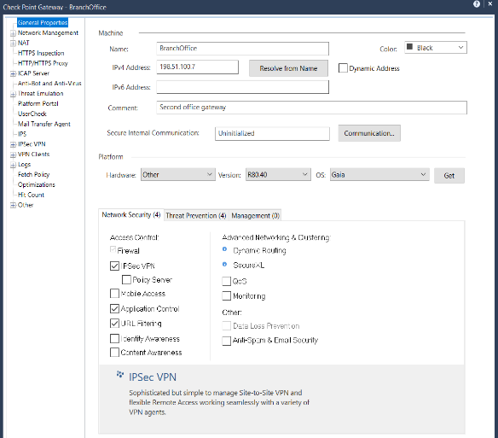
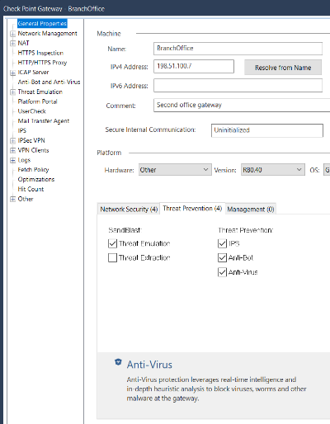
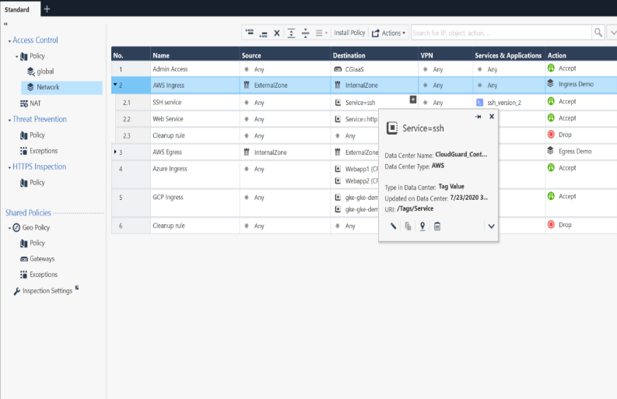
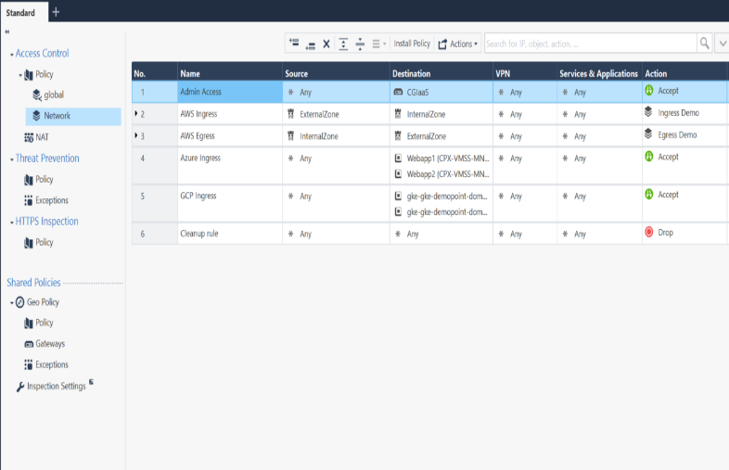
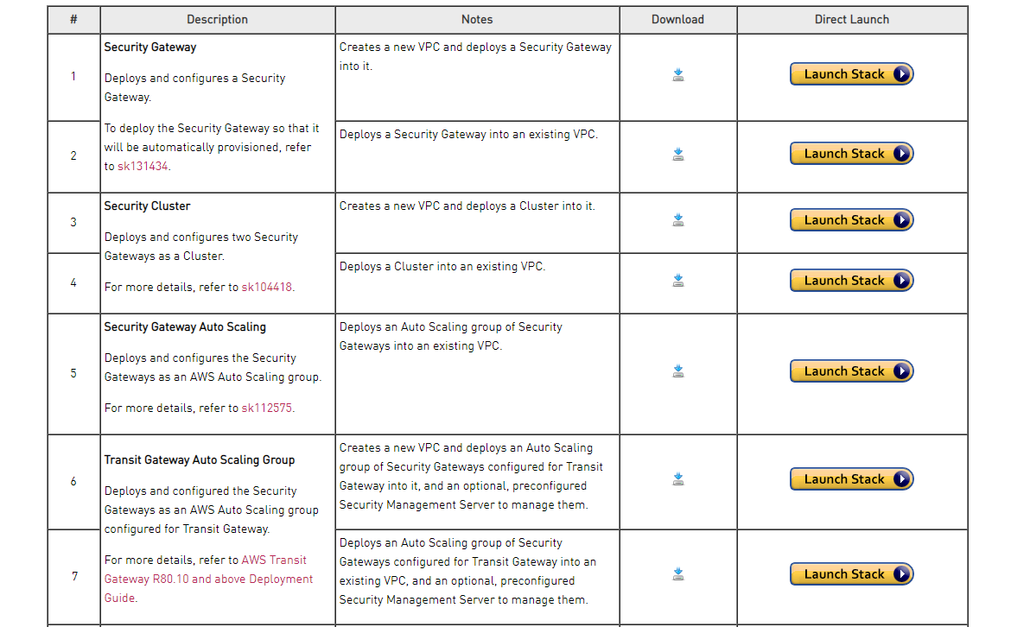

Unified Security Management
1
Unified management of cross environment policies
Tag Based Policy
2
Threat Prevention for N/S and E/W security
3
DevSecOps and Automation
4
Simple deployment with templates
Notes:
Let’s have a look at some of these use cases in a little more detail

Slide 41




Unified Security Management One policy to manage everything
Users
Cloud Assets
Applications
Data
Gateways
Public Cloud
Private Cloud
Notes:
In addition to a unified console, you also now have a unified policy to manage everything from users to data to gateways. All access points are now controlled in one place. The same goes for threat prevention policies.
We are unique in offering this level of unification, while still providing tremendous control to the security team.

Slide 42

Notes:
Placeholder if needed

